Slide 1
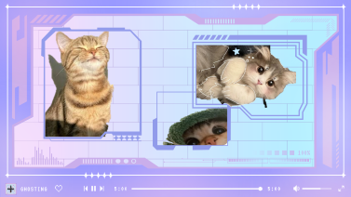

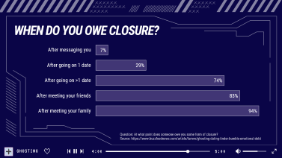
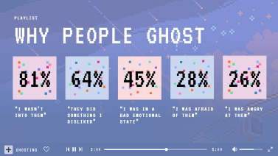
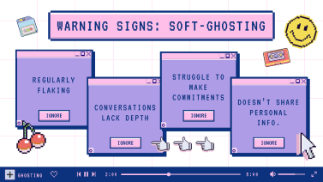
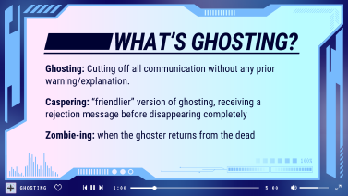
SUMMARY

Slide 2
GHOSTING

Slide 3







00:00
1
2
ABC
3
DEF
4
GHI
5
JKL
6
MNO
7
PQRS
8
TUV
9
WXYZ
0

Slide 4







WHAT’S GHOSTING?
Ghosting: Cutting off all communication without any prior warning/explanation.
Caspering: “friendlier” version of ghosting, receiving a rejection message before disappearing completely
Zombie-ing: when the ghoster returns from the dead
GHOSTING
1:00
5:00

Slide 5













WARNING SIGNS: SOFT-GHOSTING
REGULARLY FLAKING
STRUGGLE TO MAKE COMMITMENTS
CONVERSATIONS LACK DEPTH
DOESN’T SHARE PERSONAL INFO.
IGNORE
IGNORE
IGNORE
IGNORE
GHOSTING
2:00
5:00

Slide 6


WHY PEOPLE GHOST
PLAYLIST
81%
64%
45%
28%
26%
“I WASN’T INTO THEM”
“THEY DID SOMETHING I DISLIKED”
“I WAS IN A BAD EMOTIONAL STATE”
“I WAS AFRAID OF THEM”
“I WAS ANGRY AT THEM”
GHOSTING
3:00
5:00

Slide 7
WHEN DO YOU OWE CLOSURE?
Question: At what point does someone owe you some form of closure? Source: https://www.buzzfeednews.com/article/lamvo/ghosting-dating-tinder-bumble-emotional-debt
GHOSTING
4:00
5:00

Slide 8


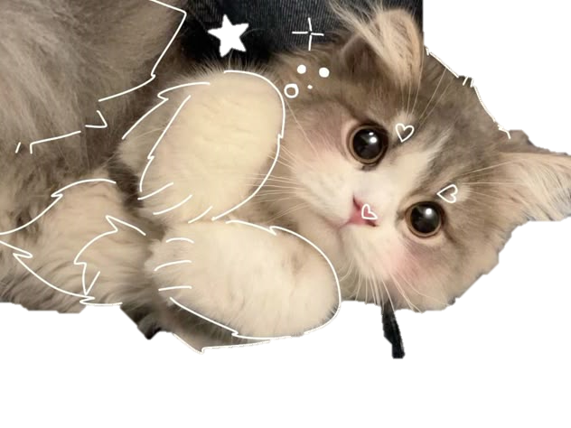



GHOSTING
5:00
5:00

Slide 9
BUT, I WOULD NEVER GHOST YOU MY LOVE MWAH
click on the heart now

